Slide 1
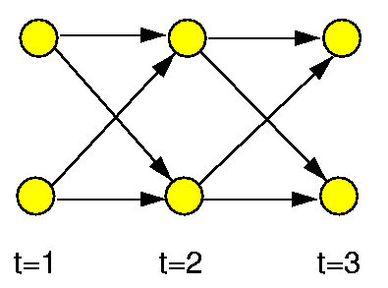
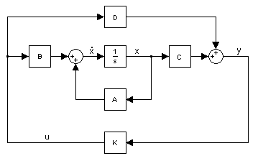
Time Series
State Space Models and Bayesian Networks

Slide 2

State Space Models
Consists of a state(or transition or system) equation and a measurement or observation equation.
Start with a simple AR(1) equation:
This is the state equation.

Slide 3

Unfortunately we cannot observe x_{t} but we can observe a related variable y_{t} such that(In the simplest case):

Slide 4
So our final model has 2 equations:
State Equation:
Observation equation:
We can generalize…..

Slide 5
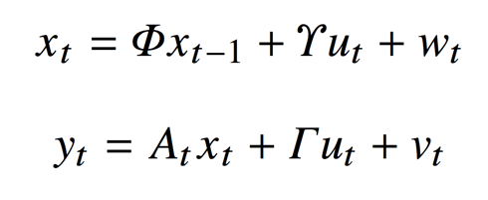
Our state space model can be expanded to incorporate exogenous variables or fixed inputs these are incorporated into u_{t}:

Slide 6
An Example
Say we have a train with constant unknown velocity and are measuring its position every second with a satellite.
If our position measurements were perfect we could know the velocity with 2 position measurements.
Our state space model would be….

Slide 7
What If we had….
Imprecise measurements (measurement error term)
Potential acceleration (state error term)
We would want some way to continually update our state estimate with our observations. With this we hope to have better and better estimates of our state at time t with only information from t-1.

Slide 8

In general…
We start with initial values… X₀ and an error covariance matrix, P₀⁰.
We use X₀ to predict X₁ , which we can call X₁⁰ and we use P₀⁰ to predict P₁⁰.
We are then given our observation y₁ and use it to reform our state and covariance matrix predictions to get X₁¹ and P₁¹.
This is an iterative process called the Kalman Filter.

Slide 9
General Notes on the Kalman Filter
Smoothing is also possibly where we start at the final time period and update our states, X, and our error matrix, P, by working backwards iteratively.
If our model parameters are unknown and we’d like to estimate them we can use an EM algorithm(or another algorithm) to obtain Maximum Likelihood estimates of parameters.

Slide 10
Kalman Filter Review
State(continuous variable) - modeled as a process
Observations - modeled with state as an input
Use observations to update our model of our state
Note: Any traditional time series model(such as VAR(p)) can be represented as a state space model.

Slide 11
What if we have Discrete States and Discrete Observations
We use a hidden markov model
Two matrices: a state transition matrix and state to observation matrix.
State transition matrix gives:
Probability of transitioning to state y from state x
State to observation matrix gives:
Probability of getting observation y given state x
These models can be applied in a large variety of situations.

Slide 12
Hidden Markov Model Example
Train hidden markov model on text with 2 states and 28 possible observations(characters plus space).
The hidden markov model with identify a “consonant” state and a “vowel” state.

Slide 13
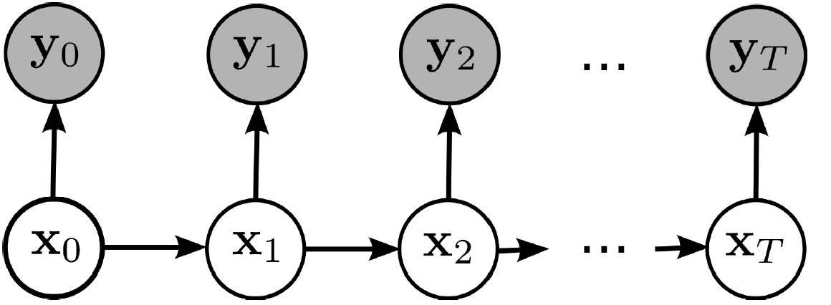
Dynamic Bayesian Networks
Kalman Filter and Hidden Markov Model can be represented as a dynamic bayesian network.
Gives visual representation of relationship between variables through time.

Slide 14
Difference between DBNs and KFM and HMM
A DBN can consist of a set of N random variables, in an HMM the state space consists only of a single random variable.
A Kalman Filter Model requires conditional probability distributions(CPD) to be linear-gaussian, whereas a DBN allows for arbitrary CPDs.
KFM and HMM have restricted graph structure as well.

Slide 15

Dynamic Bayesian Representation
For every bayesian network must define the conditional probability distribution of each node given its parents.
This means defining(If the parameters are not time-invariant this must be done recursively):

Slide 16
Discrete State DBNs
Model state transitions as:
Model Observation matrix as:
Or if the observations are continuous can use a conditional gaussian or conditional mixture of gaussians.

Slide 17
Why DBNs?
Relate a variety of modeling techniques
Facilitate easy variation on basic techniques

Slide 18
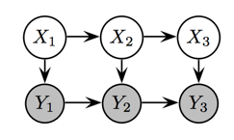
HMM variation
Auto-regressive HMM
Relaxing the assumption:
As an example:
If Y is continuous CPD could be:

Slide 19
Continuous State DBNs
A VAR(p) process with gaussian error term is equivalent to a DBN of order p where all the CPDs are gaussian.
Zeros in the regression matrices correspond to absent arcs in the DBN representation.

Slide 20
One use of DBNs….
Start with Time Series data for N variables measured every M seconds
Estimate a DBN
Project DBN at measurement rate, M to a smaller rate such as M/2
Note: Not all DBNs at rate M will project to the M/2 rate. Can slightly modify DBN by adding and removing edges to find a “projectable” DBN.
Important for….
Economic/Policy Analysis
fMRI Analysis

